Slide 1

Generative Adversarial Networks- Workshop
Presentation Title
Munich, Date

Slide 2
Agenda
Introduction
GANs Architecture
Applications of GANs
Libraries and Tools
Introductory Tutorial Torchgan
Questions

Slide 3


Real or Fake?

Slide 4

Real or Fake?

Slide 5

Real or Fake?

Slide 6
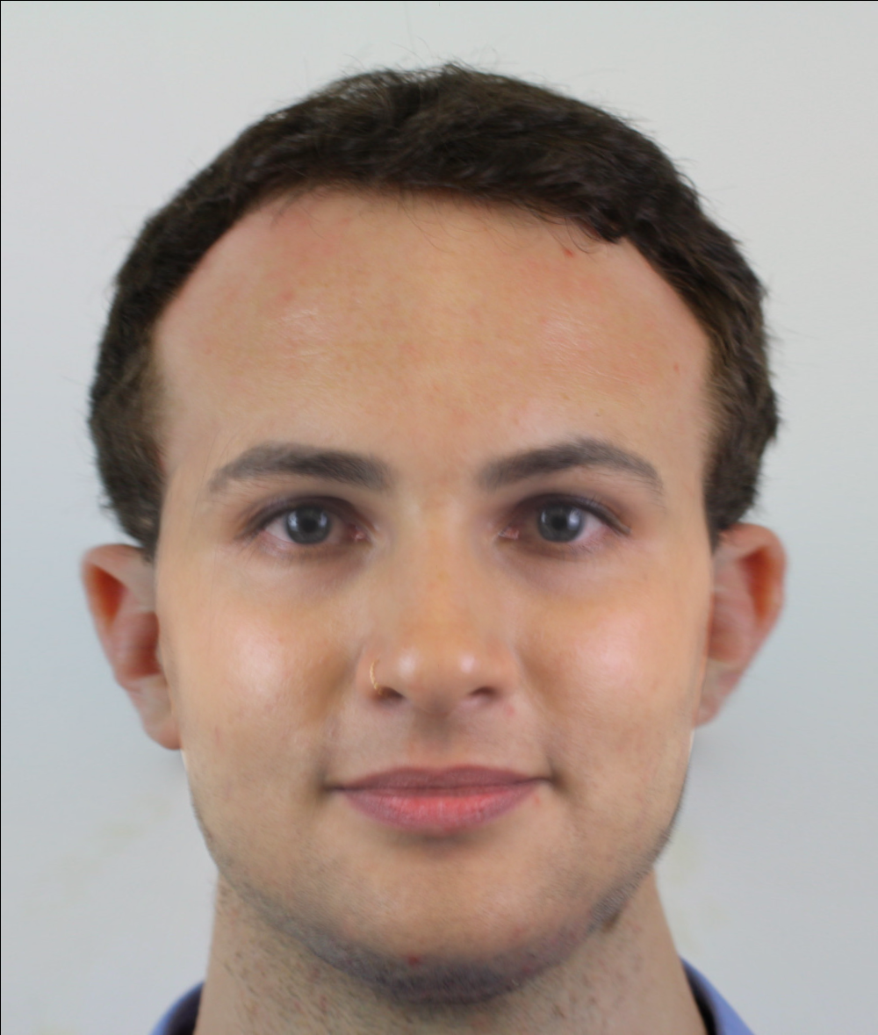
Real or Fake?

Slide 7
Generative Adversarial Networks

Slide 8
Discriminative vs. Generative Algorithm
Discriminative Models:
Predict an output y based on input x
Map features to labels
Example: Classify spam or non spam emails
Generative Models:
Learn data distribution and generate new samples
Probability of features given a label
Example: Images, videos, music, speech etc.

Slide 9
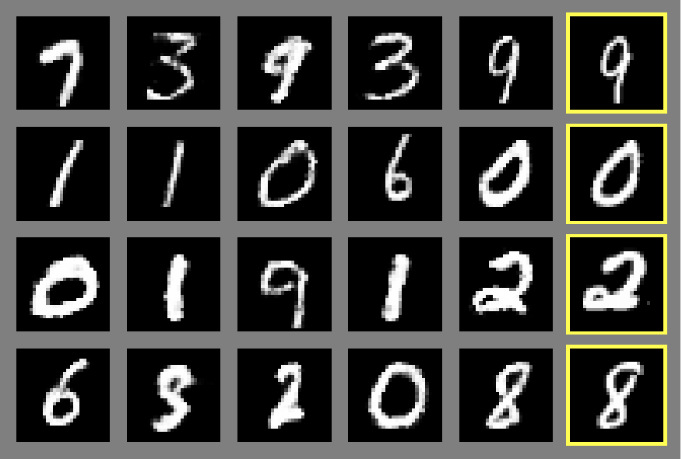
Generative Adversarial Networks (GANs)
Generative Adversarial Networks (GANs):
Deep learning based generative model introduced in 2014 by Ian Goodfellow and co-authors
GANs consist of two neural networks:
Generator: generates new samples from random noise
Discriminator: classifies samples as real or fake

Slide 10
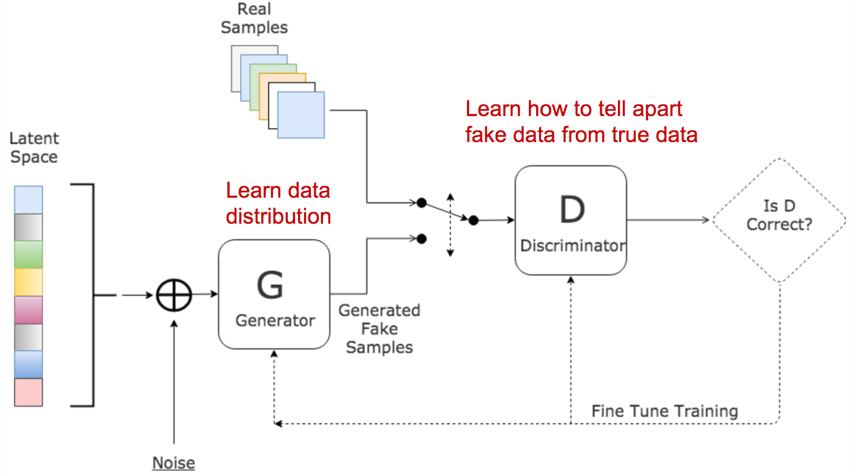
GANs Architecture
Image Source: https://www.kdnuggets.com/2017/01/generative-adversarial-networks-hot-topic-machine-learning.html

Slide 11
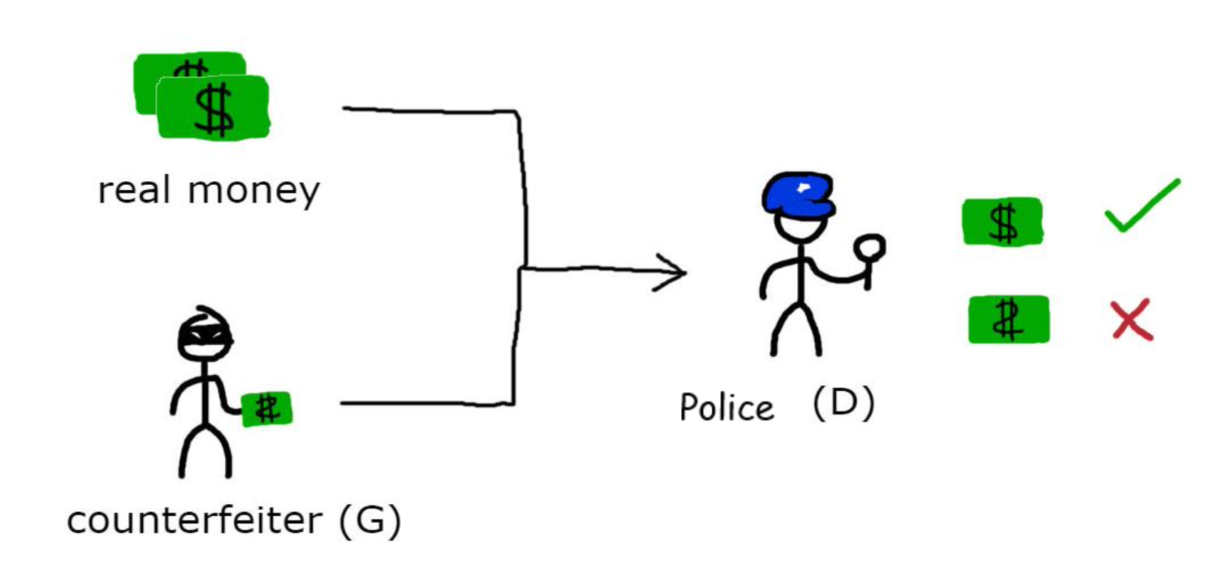
GANs - Analogy
Image Source: https://cfml.se/blog/generative_adversarial_networks/

Slide 12
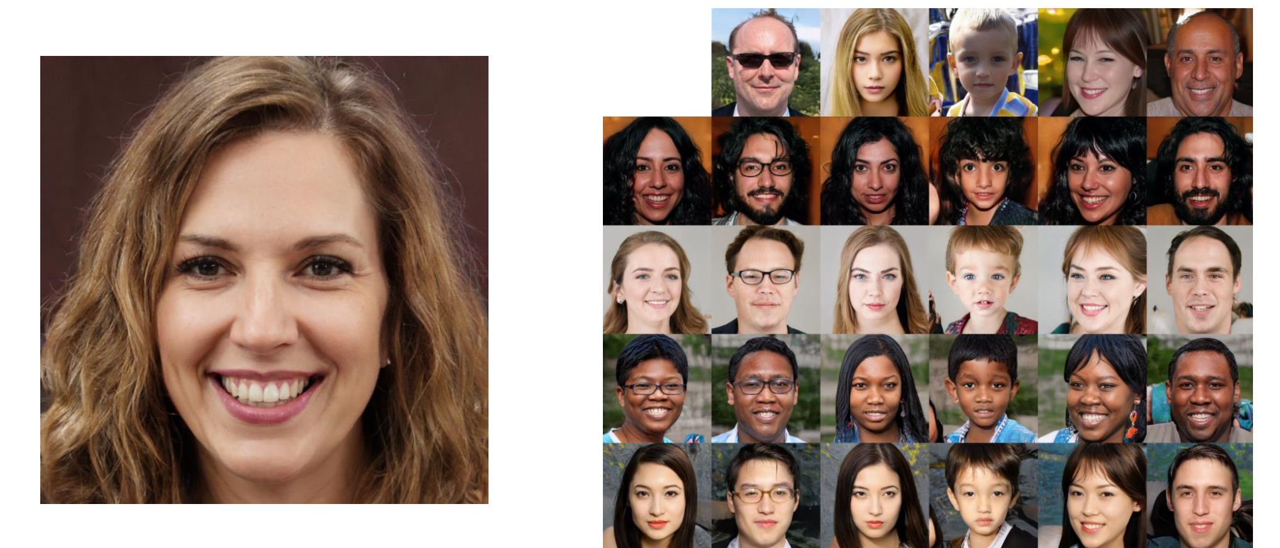
Applications of GANs - StyleGAN

Slide 13
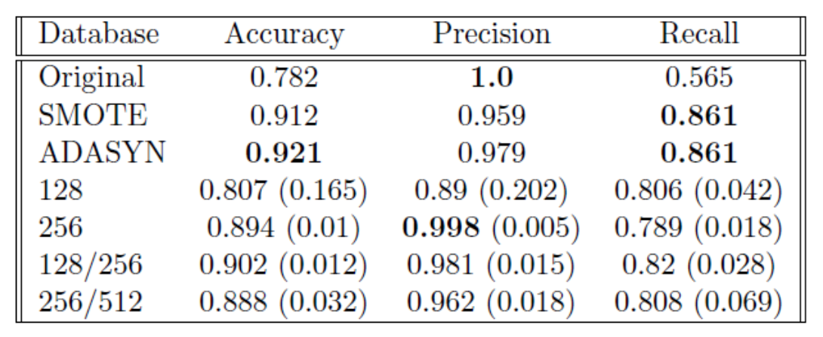
Applications of GANs– Data Augmentation for Classification Tasks
Credit Card Fraud Detection:
492 frauds/ total 284,807 transactions
Highly imbalanced, frauds are only 0.172% of all transactions
Classification Results using Augmented Data

Slide 14
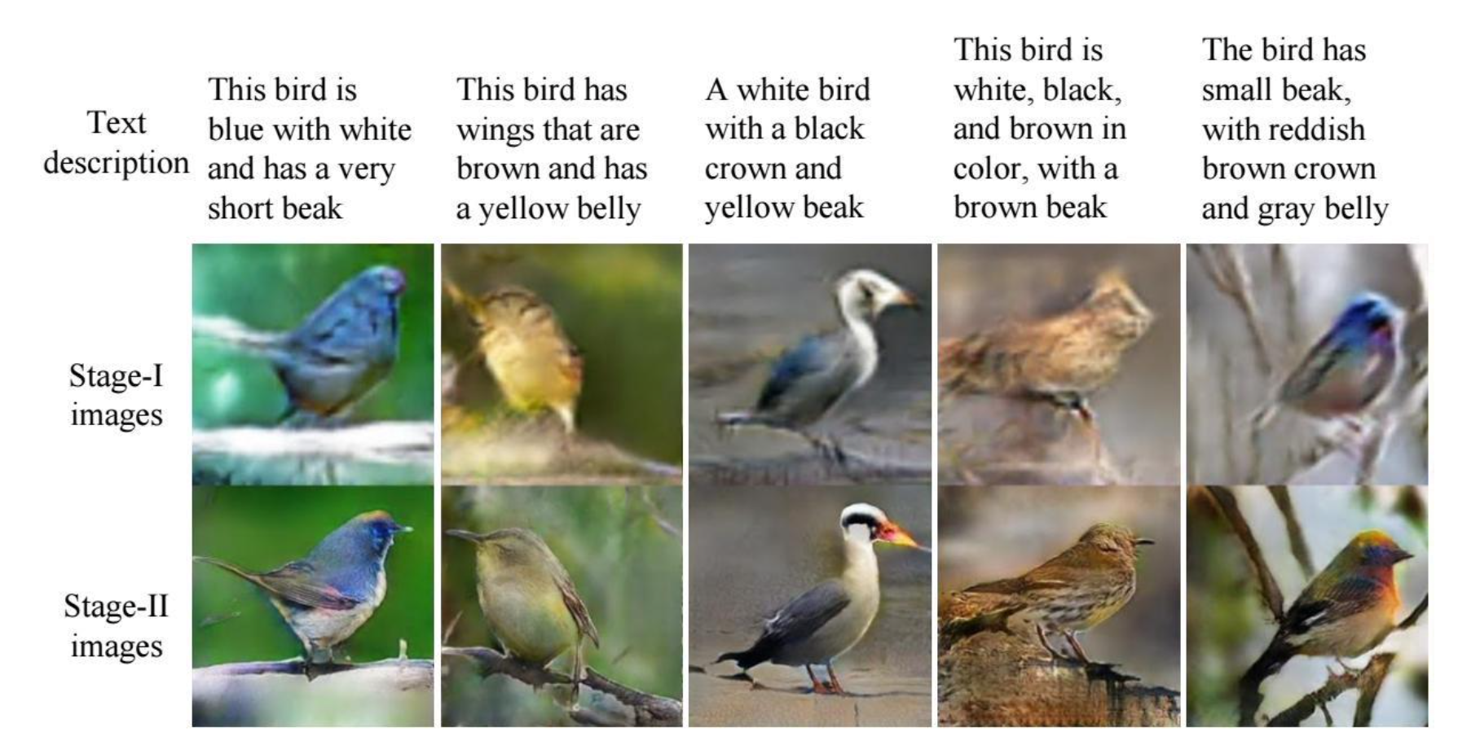
Applications of GANs - StackGAN

Slide 15
Play with GANs http://gaugan.org/gaugan2/

Slide 16
GANs Libraries and Tools

Slide 17
Libraries and Tools
1
Tensorflow
TorchGAN - tutorial
1
2
IBM GAN Toolkit
2
PyTorch
3
NV Labs Imaginaire
4
Mimicry
5
HyperGAN

Slide 18
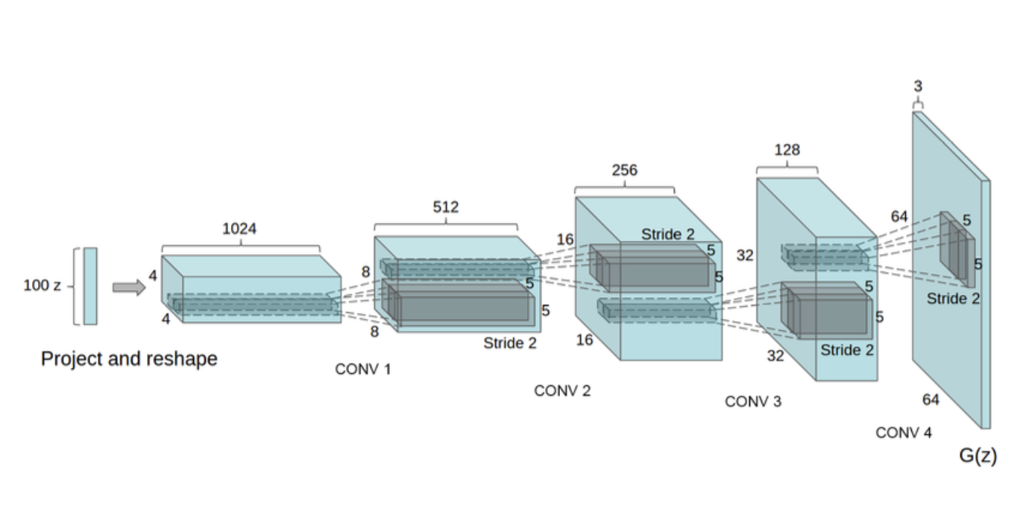
Deep Convolutional Generative Adversarial Networks - DCGANs

Slide 19
Thank you!

